Slide 1

Business Idea:
Xoxoday.com: Customer Engagement through Social Media
TEAM:
Durga Ganeshula
Muskan Jiwani
Sumith Kumar Kurapati
Kirti Moi Barua

Slide 2
Business Idea Overview
Overview:
Xoxoday.com is an experiential gifting platform. Instead of gifting objects (mugs, vouchers, etc.), people and companies gift experiences—trips, activities, adventures, dining, wellness, etc. Founded in 2012 as a corporate gifting company, later expanded to experiential gifting and rebranded to Xoxoday.

Slide 3
HOW IT WORKS
Supply side:
Xoxoday partners with brands and experience providers. They list experiences (location, price, availability).
Demand side :
Corporations use Xoxoday for employee rewards, recognition, and contests.
Transaction model:
Users buy experience voucher codes and providers fulfil the experience when the voucher is redeemed
Digital touchpoints:
Website & app: browsing and booking experiences.
APIs: used by travel agents / corporate systems.
Social media (Twitter, Facebook, etc. ) - Announcing new experiences & contests, Branding & storytelling.

Slide 4
VALUE PROPOSITION
For Corporate Customers:
Flexible Rewards & Recognition:Instead of generic gift cards, employees choose from many curated experiences.
Higher perceived value & motivation: Experiences are memorable and emotionally engaging.
Simplified bulk management: Xoxoday handles procurement, fulfilment, and tech integration.
For End Consumers:
Discoverability: Find curated, “offbeat” and unique experiences that are hard to discover alone
Convenience: Browse, pay, and gift experiences online or via the app.
Memorable gifting: Gifts are stories and memories, not just products

Slide 5
WHERE IT STRUGGLED
Strong base of repeat corporate clients, but weak new-customer acquisition. Social media activity is high (3 tweets/day, many likes/followers), but engagement (retweets, replies, click-throughs) is low.
After several years of operations, they held meetings to critique their social media strategy to find what was missing, indicating that their original approach was not working as planned
According to the case background, a large portion of Xoxoday’s business came from repeat corporate clients rather than new users. That works for stability but severely limits growth potential — the company becomes reliant on a fixed client base rather than expanding via new customers.

Slide 6
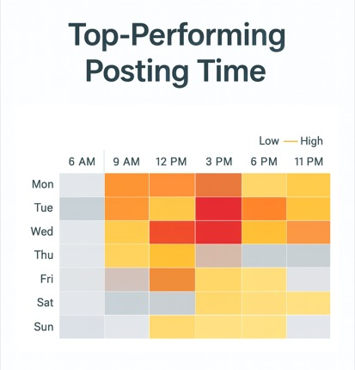
DATA VISUALIZATION
This heatmap shows the best times for Xoxoday they posted on social media based on engagement levels across different days of the week and times of day.
Each color represents engagement intensity — lighter shades show lower engagement, while darker orange and red shades represent higher engagement.

Slide 7
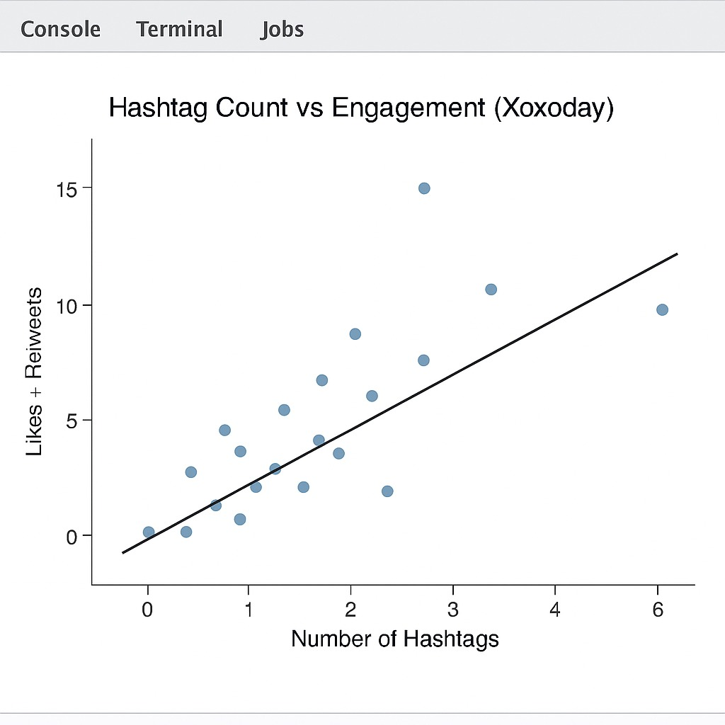
DATA VISUALIZATION
This scatter plot shows how the number of hashtags used in a Xoxoday tweet is related to the engagement it receives — measured as likes plus retweets. Each point represents a tweet, and the line shows the overall trend

Slide 8
SUMMARY FOR MODELS
1. Descriptive Analysis
Type: Exploratory statistical method used to summarize and understand data patterns
Strengths: Provides clear insights into average engagement levels (likes, retweets, replies).
Helps detect overall trends such as the impact of images and hashtag usage.
2. Correlation Analysis
Type: Statistical technique used to measure the strength of relationships between variables.
Strengths: Helps understand which factors (hashtags, timing) most influence engagement.
Visual tools like heatmaps make patterns easy to interpret.
3. K-Means Clustering
Type: Unsupervised ML algorithm - groups similar tweets based on engagement and content features.
Strengths: Reveals natural tweet categories such as high-, medium-, and low-engagement clusters.
Simplifies complex data into understandable segments.

Slide 9
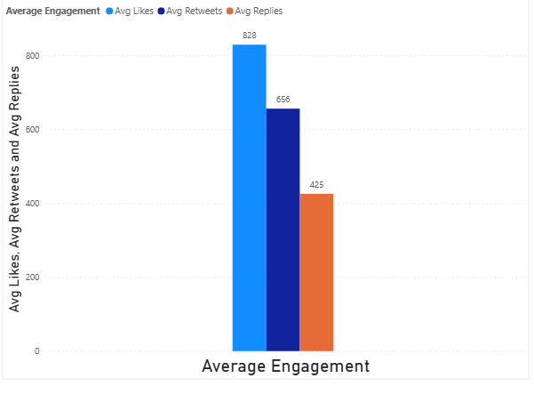
DESCRIPTIVE ANALYSIS
From the visualization, we see that Xoxoday’s tweets receive the highest engagement through likes, averaging around 828, followed by about 656 retweets and 425 replies
It shows that there is consistent engagement, but also opportunities to increase replies and retweets through more interactive or visually engaging posts

Slide 10
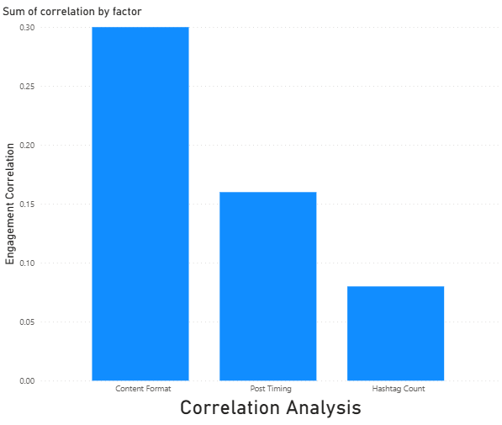
CORRELATION ANALYSIS
This bar chart shows the correlation between three important factors — hashtag count, post timing, and content format — and the engagement Xoxoday receives on Twitter. Engagement includes likes, retweets, and replies
Correlation analysis helps Xoxoday understand which factors truly drive engagement. It shows that improving content quality and posting at the right time will have a much larger impact than simply adding more hashtags

Slide 11
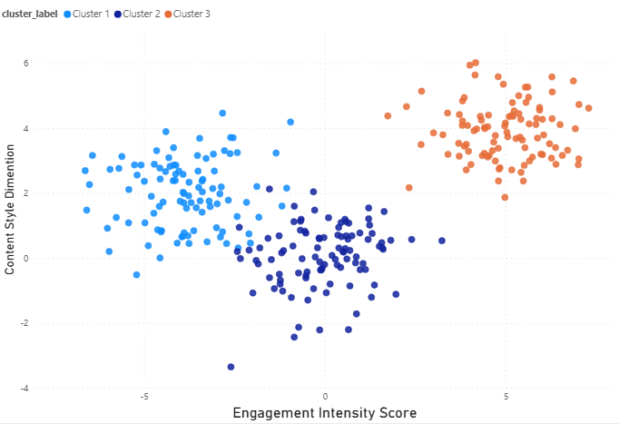
CLUSTER ANALYSIS
Each point represents a tweet, and the tweets are grouped into three clusters based on two dimensions: engagement intensity and content style.
The highest engagement comes from visually appealing and well-timed posts, whereas plain text or low-effort posts perform poorly. These insights help Xoxoday refine its content strategy by focusing on the formats and posting patterns that generate the most engagement.”

Slide 12
CONCLUSION
"The analysis of Xoxoday’s Twitter activity provides meaningful insights into how the company can enhance customer engagement and improve the effectiveness of its social media strategy. Descriptive analytics revealed that while Xoxoday consistently receives likes, retweets, and replies, engagement varies significantly based on posting time and content type. Correlation analysis further highlighted that content format and post timing are the strongest drivers of engagement, whereas hashtags offer only a moderate lift.”

